Slide 1
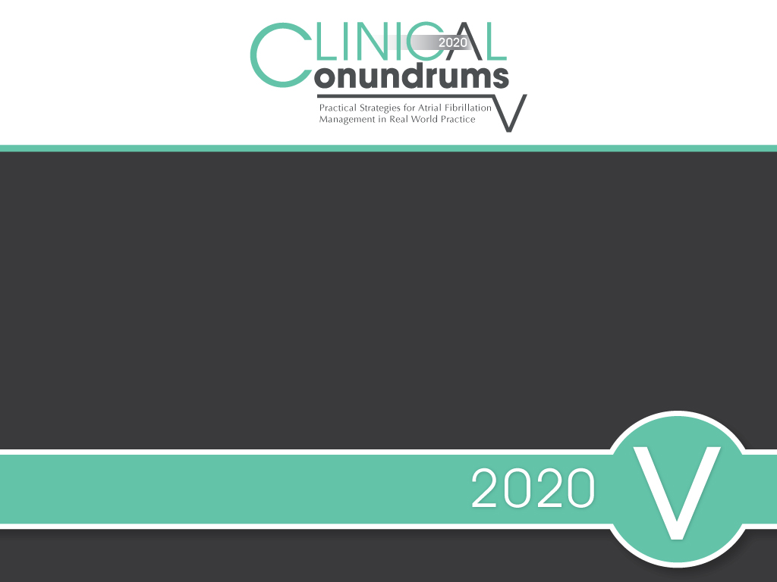

Slide 2
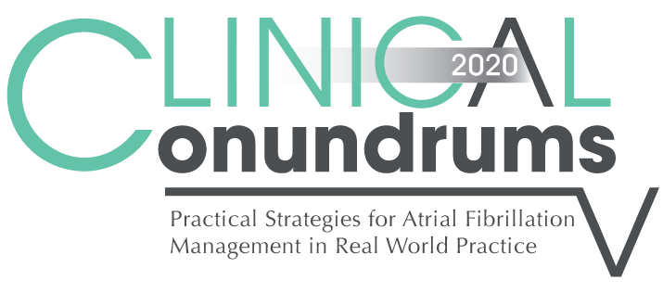

Presenter Disclosure
Presenter - [presenter name]
Relationships with financial sponsors:
Grants/Research Support:
Speakers Bureau/Honoraria:
Consulting Fees:
Patents:
Other:

Slide 3
Disclosure of Financial Support
This program has received financial support from BMS and Pfizer Alliance Canada in the form of an educational grant.
This program has received in-kind support from BMS and Pfizer Alliance Canada in the form of logistical support.
Potential for conflict(s) of interest:
[Presenter] has received [payment/funding, etc.] from [organization supporting this program AND/OR organization whose product(s) are being discussed in this program].
BMS and Pfizer Alliance Canada Canada developed, licenses, distributes and benefits from the sale of a product that will be discussed in this program

Slide 4
Mitigating Potential Bias
The Canadian Heart Research Centre (CHRC) assesses conflict of interest with its instructors, planners, managers and other individuals who are in a position to control the content of CME activities. All relevant conflicts of interest that are identified are thoroughly vetted by the CHRC for fair balance, scientific objectivity of studies utilized in this program, and patient care recommendations. The CHRC is committed to providing its learners with high quality CME activities and related materials that promote improvements or quality in healthcare and not a specific proprietary business interest of a commercial interest.
The speaker had provided a full disclosure in advance of the program. The scientific content of the program is evidence based and all content related to pharmacotherapy is within product label. The program has been peer reviewed and is nationally accredited by the College of Family Physicians of Canada.
[Presenter] has provided his disclosure information at the start of this presentation.

Slide 5

Program Development
This program was planned by the Canadian Heart Research Centre, a not-for-profit academic organization to achieve scientific integrity, objectivity, and balance.
This program has received an educational grant and in-kind support from BMS and Pfizer Alliance Canada

Slide 6
Steering Committee
George Honos, MD Clinical Conundrums Program Chair
Cardiologist Chief of cardiology Medical Director of CV Program, CHUM Associate Professor of Medicine, Université de Montréal Montreal, Quebec
Jacques Bouchard MD
Associate professor of clinical medicine
Université Laval , Québec
Head medicine department
Hôpital de la Malbaie . Québec
Jason Andrade MD
Clinical Assistant Professor
University of British Columbia
Director, Atrial Fibrillation Clinic, Electrodiagnostics, and Cardiac Electrophysiology
Paul Dorian, MD Cardiologist Director, Division of Cardiology Professor of Medicine St. Michael's Hospital University of Toronto Toronto, Ontario
Shaun Goodman, MD
Associate Head, Division of Cardiology, St. Michael's Hospital
Professor and Heart & Stroke Foundation of Ontario (Polo) Chair, Department of Medicine, University of Toronto
Adjunct Professor, Department of Medicine, University of Alberta
Jeffrey Habert, MD
Family Physician Assistant Professor
University of Toronto
Dept. of Family and Community Medicine Toronto, Ontario
Sylvain Lanthier, MD
Neurologist Neurovascular Program, CHUM
Associate Professor, University of Montreal Montreal, Quebec
John K. Marshall, MD
Professor of Medicine, and
Director, Division of Gastroenterology
McMaster University
Hamilton Ontario
L. Brent Mitchell, MD
Cardiac Electrophysiologist
Professor, Department of Cardiac Sciences
Libin Cardiovascular Institute of Alberta
University of Calgary Calgary, Alberta
Daniel Ngui, MD
Family Physician Clinical Lead, Fraser Street Medical
Clinical Associate Professor
UBC Department of Family Medicine Vancouver, British Columbia

Slide 7

Learning Objectives
Upon completion of this activity, participants should be able to:
I
Select personalized treatment options for stroke prevention in atrial fibrillation using current Canadian Practice Guidelines supplemented with reassuring “Real World” experience
II
Assess and optimize bleeding risk of atrial fibrillation patients requiring long-term DOAC stroke prevention treatment
III
Recognize the current treatment gap in Canada and take steps at ensuring appropriate dosage selection and long-term compliance with oral anticoagulation among AF patients

Slide 8

1 in 3 strokes after age 65 are attributed to AF
20% of patients die and another 60% have major disability after an embolic stroke
Despite anticoagulation being an effective treatment in AF, stroke prevention is slow to reflect evidence-based practice.
Real-world data reveal that a substantial portion of AF patients who would benefit from anticoagulation do not receive it adequately.
A large part of this suboptimal treatment is due to the underutilization and incorrect dosing of direct oral anticoagulants (DOACs).
Canadian Journal of Cardiology 34 (2018) 1412e1425
Notes:
Speaker Notes:

Slide 9
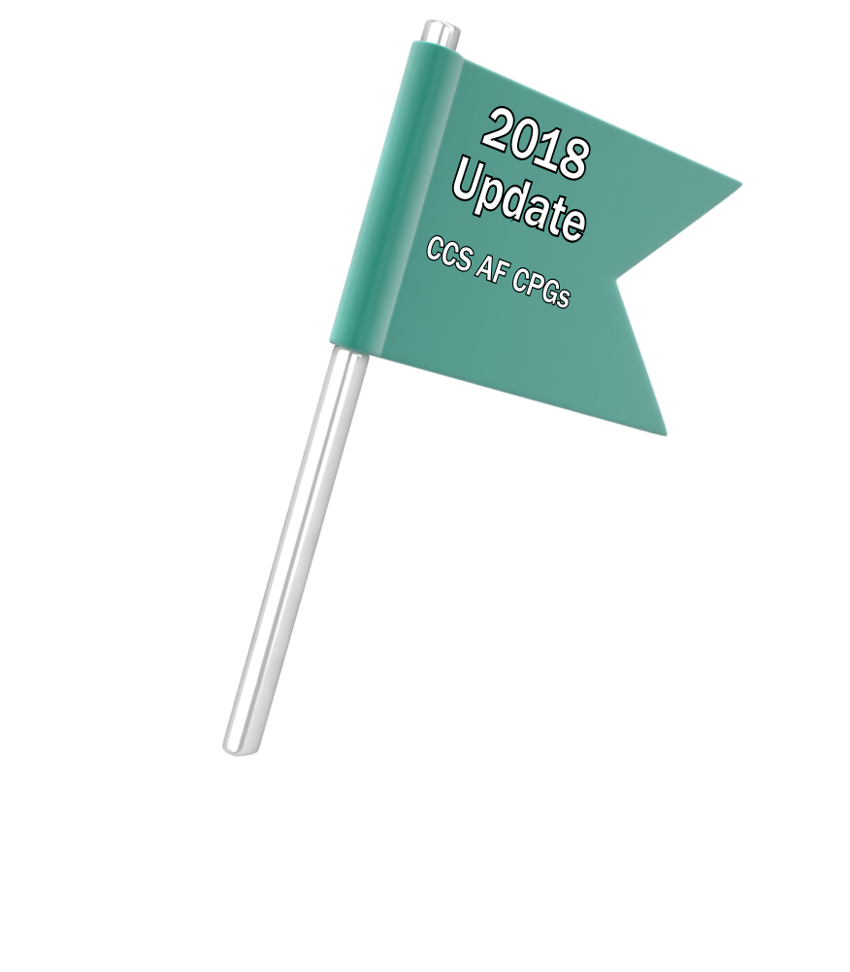
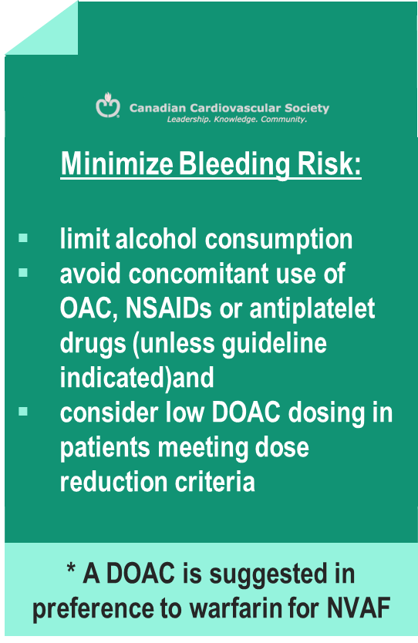
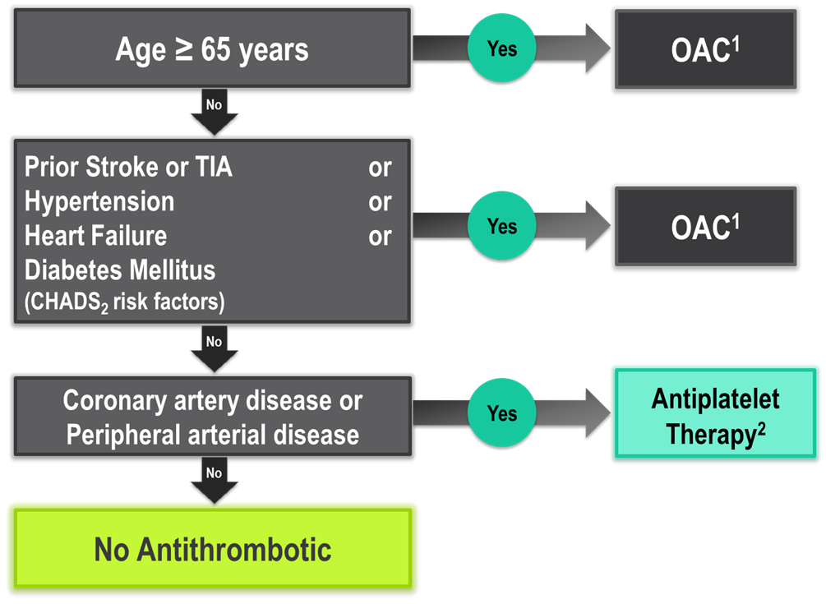
The “CCS Algorithm” (CHADS-65)
for OAC Therapy in AF
Andrade JG et al. Can J Cardiol 2018;34:1371-1392
CCS AF Guidelines. Can J Cardiol. 2016; 32: 1170-1185
¹ A DOAC is preferred over warfarin in non-valvular AF
² Therapeutic options include single antiplatelet therapy (ASA 81-100 mg daily) alone; or in combination with either a second antiplatelet agent (e.g. clopidogrel 75 mg daily or ticagrelor 60 mg BID), or an antithrombotic agent (rivaroxaban 2.5 mg BID)
Notes:
Speaker Notes:
This is the new and important slide from the 2018 (box to the right is from the 2016 update) Canadian AF guidelines update.
Two key points to emphasize: the (*) indicates that a DOAC should be selected in preference to an AVK for anticoagulation. The shaded box to the right emphasizes that all efforts should be made to select the correct DOAC dosage based on age, size and renal function as well as to minimize the bleeding risk by addressing any modifiable bleeding risk factors present.
There is no longer any need to calculate a patient’s HASBLED score as this does not influence management (most patients are antioagulated even, if at higher bleeding risk..)
Canada has not adopted the CHADSVASC scoring system to determine eligibility for oral anticoagulation in AF. The annual embolic stroke risk threshold for anticoagulation is set at 1.5% and it is felt that a vascular diseased patient who is aged 64 or less and CHADS2 = 0 has an annual stroke risk of less than 1.5% based on the Canadian Guideline Committee’s interpretation of currently available large data sets.

Slide 10
Operational Definition of Non-Valvular Atrial Fibrillation (NVAF)
“Valvular” AF includes :
Mechanical heart valve
Rheumatic moderate or severe mitral valve stenosis (MS) *
NVAF (“ non-valvular” AF) therefore includes :
Mitral regurgitation (MR)
Aortic stenosis (AS)
Aortic insufficiency (AI)
Remote (3-6 months) tissue prosthetic heart valve
Remote (3-6 months) surgical valve repair
* It is uncertain whether patients with only mild MS or post mitral commissurotomy should be regarded as “Valvular” AF.
Macle L et al. Can J Cardiol 31:1207-18, 2015
De Caterina R, et al. Eur Hear J 2014;35:3328-35

Slide 11
DOACs vs Warfarin RCTs Baseline Characteristics
 | RE-LYª ^{(Dabigatran)} | ROCKET-AF^{b} ^{(Rivaroxaban)} | ARISTOTLE^{c} ^{(Apixaban)} | ENGAGE AF^{d} ^{(Edoxaban)}
Randomized, N | 18,113 | 14,264 | 18,201 | 21,105
Age, y | 72±9 | 73 [65-78] | 70 [63-76] | 72 [64-78]
Female, % | 37 | 40 | 35 | 38
Paroxysmal AF, % | 32 | 18 | 15 | 25
VKA naive, % | 50 | 38 | 43 | 41
Aspirin use, % | 40 | 36 | 31 | 29
CHADS 2
0-1
2
3-6
Connolly SJ, et al. N Engl J Med. 2009;361:1139-1151^{[3];}
Patel MR, et al. N Engl J Med. 2011;365:883-891^{[4];}
Granger CB, et al. N Engl J Med. 2011;365:981-992^{[5];}
Giuliano RP, et al. N Engl J Med. 2013;369:2093-2104.^{[6}

Slide 12
DOACs as Compared to Warfarin Indirect Comparisons from the Clinical Trials
 | Apixaban¹ | Dabigatran 110² | Dabigatran 150² | EDOXABAN 60 | Rivaroxaban³
Stroke/SE
Major Bleed
Intracranial Bleed
GI Bleed
All Cause Death
To date there are no head-to-head trials between apixaban, dabigatran, edoxaban and rivaroxaban, therefore comparative efficacy and safety have not been established
Significant Increase
Significant Reduction
Non-Significant Difference
Granger et al., NEJM 2011; 365: 981-992
Connolly et al., NEJM 2009; 361: 1139-1151
Patel et al., NEJM 2011; 365: 883-891
Giuliano RP et al NEJM 2013; 369:2091

Slide 13
Stroke Prevention in AF: Clinical Pharmacology and Dosing of DOACs
 | Apixaban | Dabigatran | EDOXABAN | Rivaroxaban
Mechanism of action | Direct Factor Xa inhibitor | Direct thrombin inhibitor | Direct Factor Xa inhibitor | Direct Factor Xa inhibitor
Oral bioavailability | ~50% | ~6.5% | 62% | 80-100%
Pro-drug | No | Yes | No | No
Food effect | No | No | No | Yes (needs to be taken with food)
Renal clearance | ~27% | 85% | 50% | 36% *
Mean half-life (t_{1/2}) | ~12 h | 11-17h | 10-14h | 5-13 h
T_{max} | 3-4 h | 0.5-2 h | 1-2h | 2-4 h
Recommended daily dose | 5 mg BID | 150 mg BID | 60 mg QD | 20 mg QD
Pfizer Canada Inc./BMS Canada. Eliquis (apixaban) Product Monograph, June 16, 2016.
Boehringer Ingelheim Canada Ltd. Pradaxa (dagbatran) Product Monograph. August 11, 2016.
Bayer Inc. Xarelto (rivaroxaban) Product Monograph. July 20, 2015.
Daiichi Sankyp Inc. Lixiana (edoxaban) Product Monograph. November 2, 2016.
* Rivaroxaban is 66% renally cleared and its active metabolite is 36% renally cleared

Slide 14
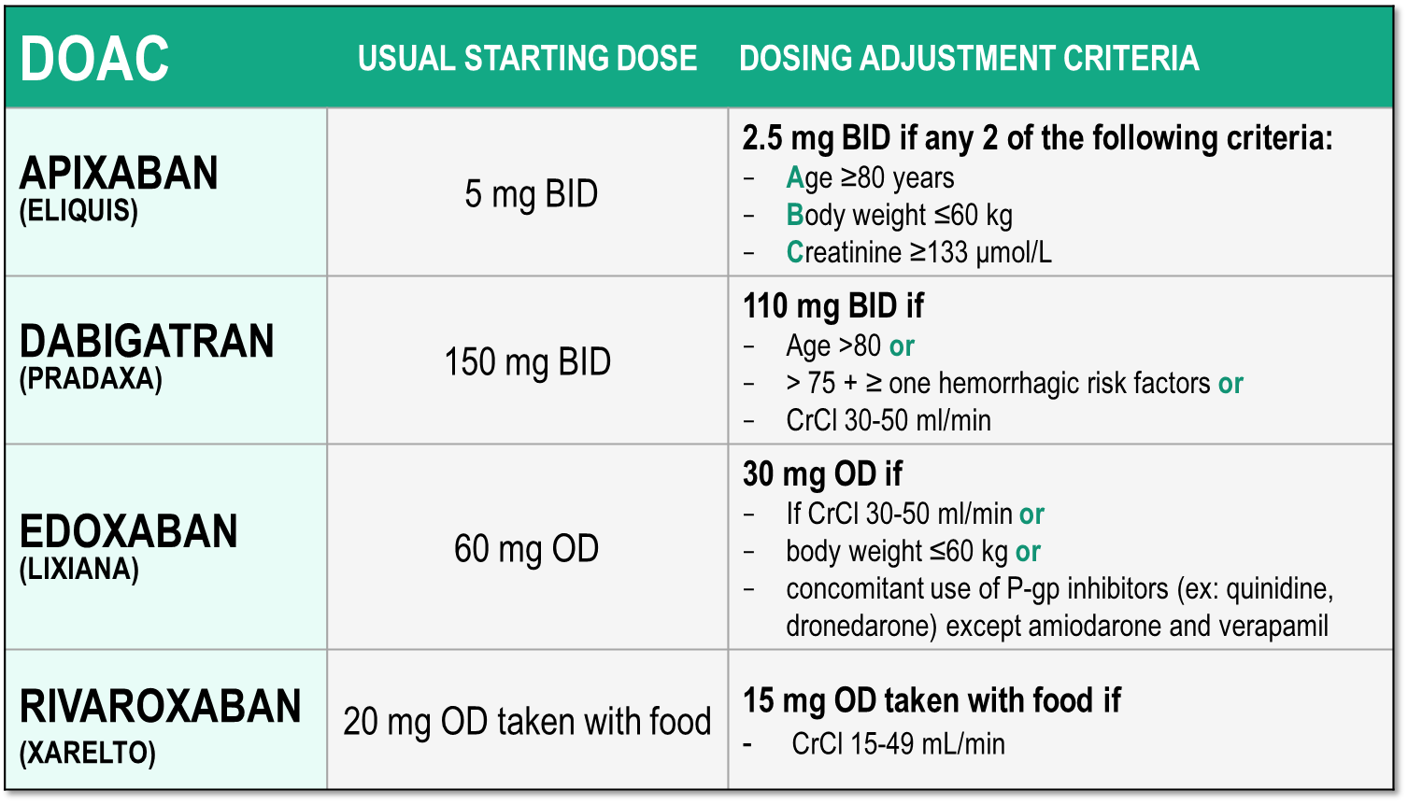
Considerations for Dosing of DOACs
Pfizer Canada Inc./BMS Canada. Eliquis (apixaban) Product Monograph, 2018.
Boehringer Ingelheim Canada Ltd. Pradaxa (dagbatran) Product Monograph. August 11, 2016.
Bayer Inc. Xarelto (rivaroxaban) Product Monograph. 2018.
Daiichi Sankyp Inc. Lixiana (edoxaban) Product Monograph. 2017.

Slide 15
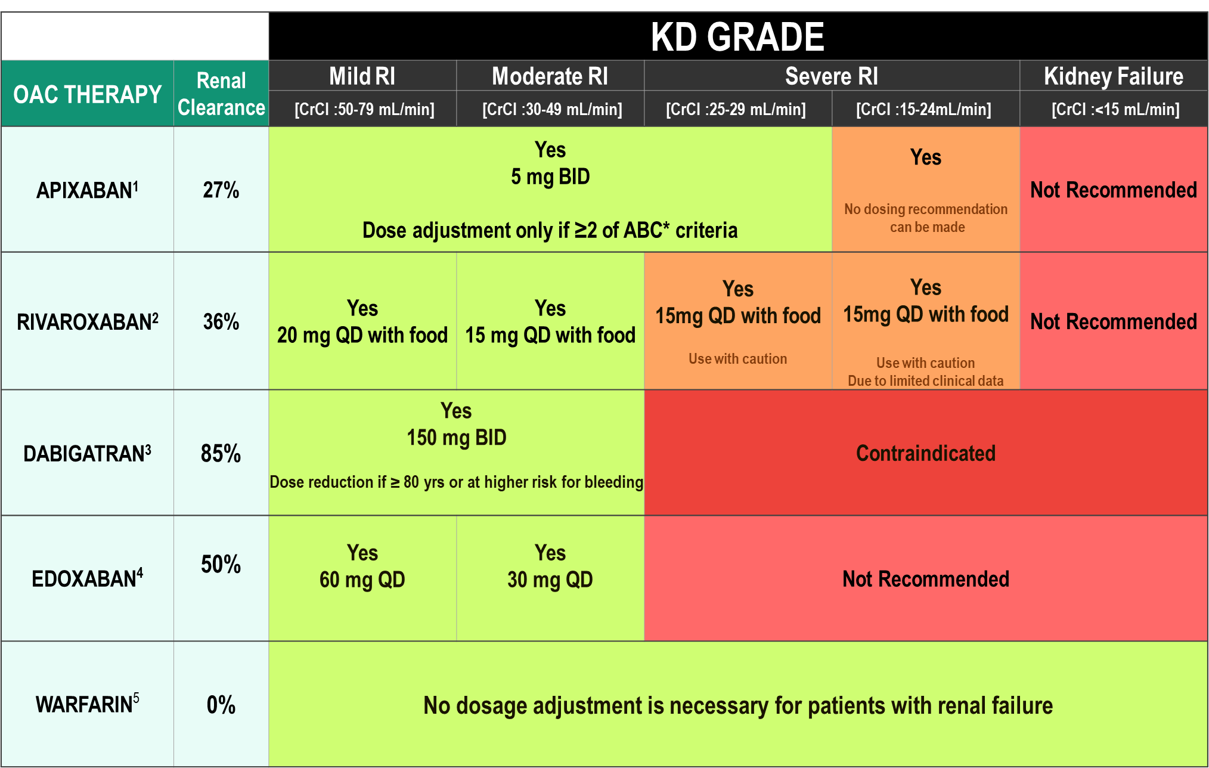
DOAC Dosing Recommendations for Stroke Prevention in AF in Patients with Renal Impairment According to the Canadian Product Monographs
Pfizer Canada Inc./BMS Canada. Eliquis (apixaban) Product Monograph, 2018.
Boehringer Ingelheim Canada Ltd. Pradaxa (dagbatran) Product Monograph. August 11, 2016.
Bayer Inc. Xarelto (rivaroxaban) Product Monograph. 2018.
Daiichi Sankyp Inc. Lixiana (edoxaban) Product Monograph. 2017.

Slide 16
DOAC Antidotes
Andexanetª ^{(PRT064445)} | Antidote for factor Xa inhibitors Recombinant protein binding to factor Xa inhibitor site
Aripazine^{b} ^{(PER977)} | Antidote for factor Xa inhibitors, direct thrombin inhibitors, low molecular-weight heparins, and fondaparinux Synthetic small molecule; reversal effect through direct binding to anticoagulant
Idarucizumab^{c} ^{(BI 655075)} | Antidote for direct thrombin inhibitors Fully humanized antibody fragment
a. Clinicaltrials,gov; NCT01758432 16; b Dolgin E. Nat Med. 2013;19:251(17), c, Clinicaltrials.gov;NCT01955720.{18}

Slide 17

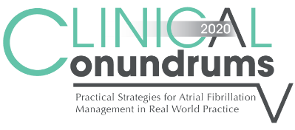
What are the patterns of
reduced dose use in Canada?

Slide 18
Appropriate Use of Antithrombotic Medications in Canadian Patients with NVAF
7,019 patients with NVAF from 735 primary care physician practices
Over 90% of patients with CHADS₂ >1 receiving oral anticoagulation
BUT ….
Over 50% of patients on OAC taking warfarin
30.9% of patients on warfarin TTR < 65%
Of the patients on DOACs, 11.7% were on the wrong dose
7.4% under-dosed
4.3% over-dosed
Additional 3.2% of patients on DOAC were contraindicated by renal function
NVAF: Non Valvular Atrial Fibrillation
Bell AD, et al. Am J Cardiol. 2016 Apr 1;117(7):1107-11

Slide 19
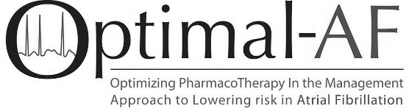
DOAC Dose and Lower Dose Concordance*
Apixaban (n=556⁺)
Dabigatran (n=181⁺)
Rivaroxaban (n=369⁺)
*Concordant with Health Canada Product Monograph prescribing recommendations
⁺Dosing information available
Non-vitamin K antagonist Oral Anticoagulant (NOAC) Use and Dosing in Canadian Practice: Insights from the Optimizing PharmacoTherapy in the Management Approach to Lowering risk in Atrial Fibrillation (OPTIMAL-AF) Program - CCS 2018 Poster Presentation
Notes:
Speaker Notes:
Of the 556 AF patients on Apixaban, 23% were given the reduced dose of 2.5 mg bid of whom about half (13% of the total) did not have 2 of the 3 “ABC” criteria present (age ≥ 80, weight ≤ 60 kg, creatinine ≥ 133)
Of the 181 patients on Dabigatran, 38% were on the reduced dose of 110mg bid and only 4% were felt to be on a dosage that was discordant with current Canadian Guidelines
Of the 369 patients on Rivaroxaban, 18% were on a reduced dose and 8% were felt to have been reduced to 15 mg daily inappropriately.
Overall, the message is that there is some room for improvement through further knowledge dissemination

Slide 20
What are real world data good for?
What are the real-world outcomes in
patients receiving DOACs?

Slide 21
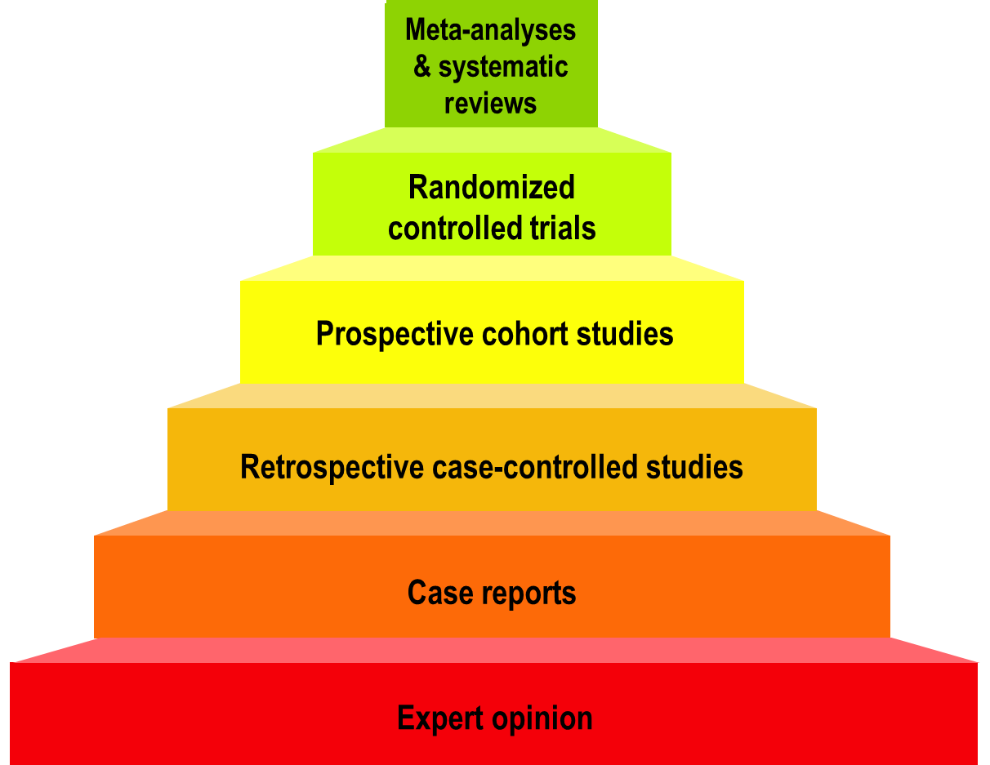
Hierarchy of Medical Evidence
Stronger
Observational
studies
Weaker
Modified from the logicofscience.com
Notes:
Speaker Notes:
It is important to emphasize that randomized controlled trials (RCTs) represent the strongest type of medical evidence to guide management of patients.
Observational studies vary on quality and can be confirmatory and reassuring when results agree with those of RCTs. When there is disagreement with RCTs, observational studies are considered “hypothesis generating” and findings need to be prospectively confirmed by randomized RCTs.

Slide 22
Not Medical Evidence
Patient wishes or testimonials
Celebrity endorsement
Experience with your last patient
Gut feeling
Familial instinct
Information from those who are biased
Modified from the logicofscience.com
Notes:
Speaker Notes:
This slide is self-explanatory and may be used at the speakers discretion to emphasize some of the many barriers we face in ensuring long-term patient compliance to DOACs in a world of “fake-news” and multiple different “opinions” from biased sources who often have a less than scientific personal agenda… Patients (and physicians..) must beware in a world of readily accessible (mis)information!

Slide 23
What are RWD Studies Good for?
Describe how the therapy is being used
Enable comparisons not available from RCTs
Describe outcomes in niche patient populations
Enable subgroup studies for individualized Rx
Unique observations generate hypotheses
Use large samples to identify rare events
NEVER to refute significant RCT findings
Modified from the logicofscience.com
Notes:
Speaker Notes:
This slide can be used to elaborate on comments made to slide 22 and list some of the potential uses of observational RWD studies.

Slide 24
What is “Propensity Score Matching”?
Doctors prescribe different treatments to different kinds of patients (patient characteristics determine their propensity to receive treatment X).
Propensity matching attempts to correct for this difference by matching patients in one group with patients in the other group based on the characteristics defining their propensity to be in one group rather than the other.
Does not correct for every propensity difference.
Modified from the logicofscience.com
Notes:
Speaker Notes:
This slide is useful when describing how non-randomized “big data” is used in Real World studies. Propensity score matching attempts to correct for the absence of prospective randomization when analyzing data retrospectively. Only variables that are available in the dataset can be matched and corrected for leaving plenty of room for unaccounted for bias. This is why propensity score matching can never be as powerful as prospective double blind randomization where groups are generally identical except for the variable (e.g. drug) under investigation.
May be used as a backup slide at the presenter’s discretion

Slide 25
RWD Studies Are Different
STRONGER REAL-WORLD DATA | WEAKER REAL WORLD DATA
Prospective; purpose-specific data | Retrospective; convenience data
Propensity matched study populations | Unmatched study populations
Large patient populations | Small patient populations
Representative patient populations | Selected patient populations
Standard outcomes (same as the RCTs) | Unusual outcomes (different than RCTs)
Outcomes for efficacy and safety | Single sided outcomes
Follow-up durations long | Follow-up durations short
Funding independent of industry | Funded by industry
Analysis independent of industry | Analysis by industry
Sensitivity analysis for biases | No sensitivity analysis for biases
TEMPORAL TRENDS AND SAFETY | UNCOMMONLY HELPFUL
Adapted from Dang A, Kaur K. Perspect Clin Res 2016; 7(1): 9-14.
Notes:
Speaker Notes:
Slide compares the strengths and weaknesses of observational real world data, empowering the attendee to better discriminate between the growing number of RWD studies published each year.
Useful adjunct to slide 26 depending on the audience interest in the subject

Slide 26
DOACs as Compared to Warfarin Clinical Trials vs Real World Data (RWD)
 | Apixaban Aristotle Study¹ | RWD⁴ | Dabigatran RELY STUDY² | RWD⁴ | Rivaroxaban ROCKET STUDY³ | RWD⁴
Stroke/SE
Major Bleed
Intracranial Bleed
GI Bleed
All Cause Death
To date there are no head-to-head trials between apixaban, dabigatran and rivaroxaban, therefore comparative efficacy and safety have not been established
Significant Increase
Significant Reduction
Non-Significant Difference
Granger et al., NEJM 2011; 365: 981-992
Connolly et al., NEJM 2009; 361: 1139-1151
Patel et al., NEJM 2011; 365: 883-891
YAO et al. J Am Heart Assoc 2016;5:e003725
Notes:
Speaker Notes:
This slide shows some key efficacy and safety outcome data vs. warfarin from the three major new OAC trials: RE-LY, ROCKET and ARISTOTLE
Dabigatran 150 mg and apixaban 5 mg are associated with significant reduction of stroke/SE vs. warfarin.
Dabigatran 110 mg and apixaban 5 mg are associated with significant reduction of major bleeding vs. warfarin.
All new OACs are associated with a significant reduction of ICH compared to warfarin.
Apixaban is associated with significant reduction of mortality compared to warfarin.
Definition of major bleeding:
RE-LY: a reduction in the hemoglobin level of at least 20 g per liter, transfusion of at least 2 units of blood, or symptomatic bleeding in a critical area or organ.
ROCKET: as clinically overt bleeding associated with any of the following: fatal outcome, involving a critical site (i.e., intracranial, intraspinal, intraocular, pericardial, intraarticular, intramuscular with compartment syndrome, or retroperitoneal), or clinically overt bleeding associated with a fall in hemoglobin concentration of ≥ 2 g/dL, or leading to transfusion of ≥ 2 units of packed red blood cells or whole blood.
ARISTOTLE: clinically overt bleeding accompanied by a decrease in the hemoglobin level of at least 2 g per deciliter or transfusion of at least 2 units of packed red cells, occurring at a critical site, or resulting in death.

Slide 27
ARISTOPHANES:
Rate of Stroke/SE and Major Bleeding Among Patients With NVAF Who Were Prescribed NOACs or Warfarin
Study Objectives: Compare the rate of stroke/SE and major bleeding among a large number of patients with NVAF on NOACs or warfarin
Retrospective, observational cohort study
A total of 466 991 patients with NVAF were included in the study:
Apixaban (n = 108,852)
Dabigatran (n = 37,724)
Rivaroxaban (n = 153,002)
Warfarin (n = 167,413)
Lip et al. Stroke. 2018;49:2933-2944; updated January 10, 2020.
Notes:
Speaker Notes:
Reference: Lip GYH, Keshishian A, Li X, et al. Effectiveness and safety of oral anticoagulants among nonvalvular atrial fibrillation patients [published correction appears in Stroke. 2020;0:STR.0000000000000218]. Stroke. 2018;49(12):2933-2944.
Study Design and Population:
Retrospective, observational cohort study
Pooled data from the CMS Medicare and 4 large commercial claims databases in the US: MarketScan, PharMetrics, Optum, and Humana
Study period: 1/1/2012–9/30/2015
Outcomes:
Effectiveness outcome: Time to first stroke/SE, including ischemic stroke, hemorrhagic stroke, and SE
Safety outcome: Time to first major bleeding, including gastrointestinal bleeding, intracranial hemorrhage, and major bleeding at other key sites
Key Patient Characteristics:
A total of 466 991 patients with NVAF were included in the study:
Apixaban (n = 108 852)
Dabigatran (n = 37 724)
Rivaroxaban (n = 153 002)
Warfarin (n = 167 413)
Authors’ Summary of Study Strengths: To the authors’ knowledge, this is the largest retrospective, observational study to date to examine the rate of stroke/SE and major bleeding among patients with NVAF who initiated NOAC treatment. Due to the large, pooled dataset, this analysis has improved generalizability and more statistical power to evaluate less frequent events (eg, intracranial hemorrhage) and subgroups with limited sample size (eg, peripheral artery disease) in randomized clinical trials.
The time frame for inclusion in the study was from 1/1/2013 to 9/30/2015.
Although overlapping at the health plan level was expected to be minimal, duplicate patient records may have existed. However, the percentage of those potential duplicates in a previously published pooled analysis was estimated to be small (0.5%) and, therefore, not likely to have affected the study results. (Broder et al. Pituitary. 2014;17[4]:333-41. doi: 10.1007/s11102-013-0506-0; Li et al. PLoS ONE. 2018;13[1]:e0191722.)

Slide 28
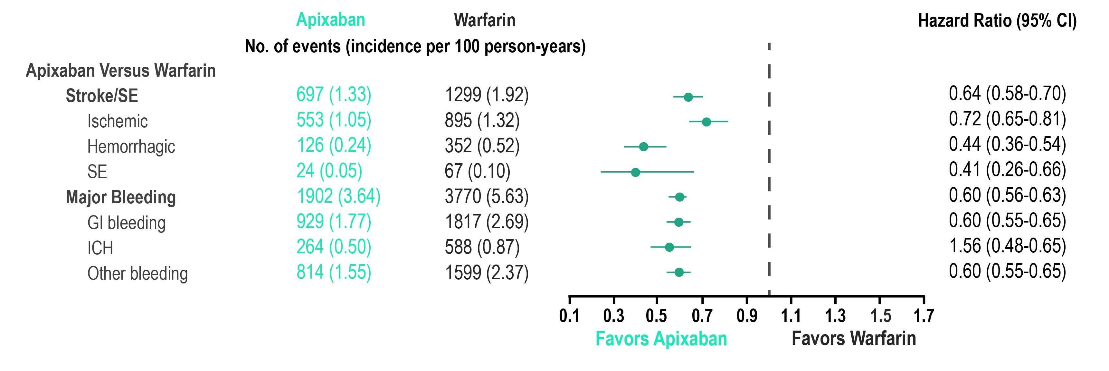
Main Analysis: Incidence Rates and Hazard Ratios of Stroke/SE and Major Bleeding in Apixaban–Warfarin Propensity Score-Matched Cohorts
Limitations: No adequate, well-controlled head-to-head clinical trials have been conducted comparing the efficacy and safety of NOACs. Each cohort was matched separately. Therefore, it is not appropriate to compare across the cohorts.
CI, confidence interval; GI, gastrointestinal; ICH, intracranial hemorrhage; NOAC, non-vitamin K antagonist oral anticoagulant; NVAF, nonvalvular atrial fibrillation; SE, systemic embolism.
Lip et al. Stroke. 2018;49:2933-2944; updated January 10, 2020.
Notes:
Speaker Notes:
Authors’ Summary: Compared with warfarin, apixaban was associated with lower rates of stroke/SE, ischemic stroke, hemorrhagic stroke, SE, major bleeding, GI bleeding, ICH, and other bleeding

Slide 29
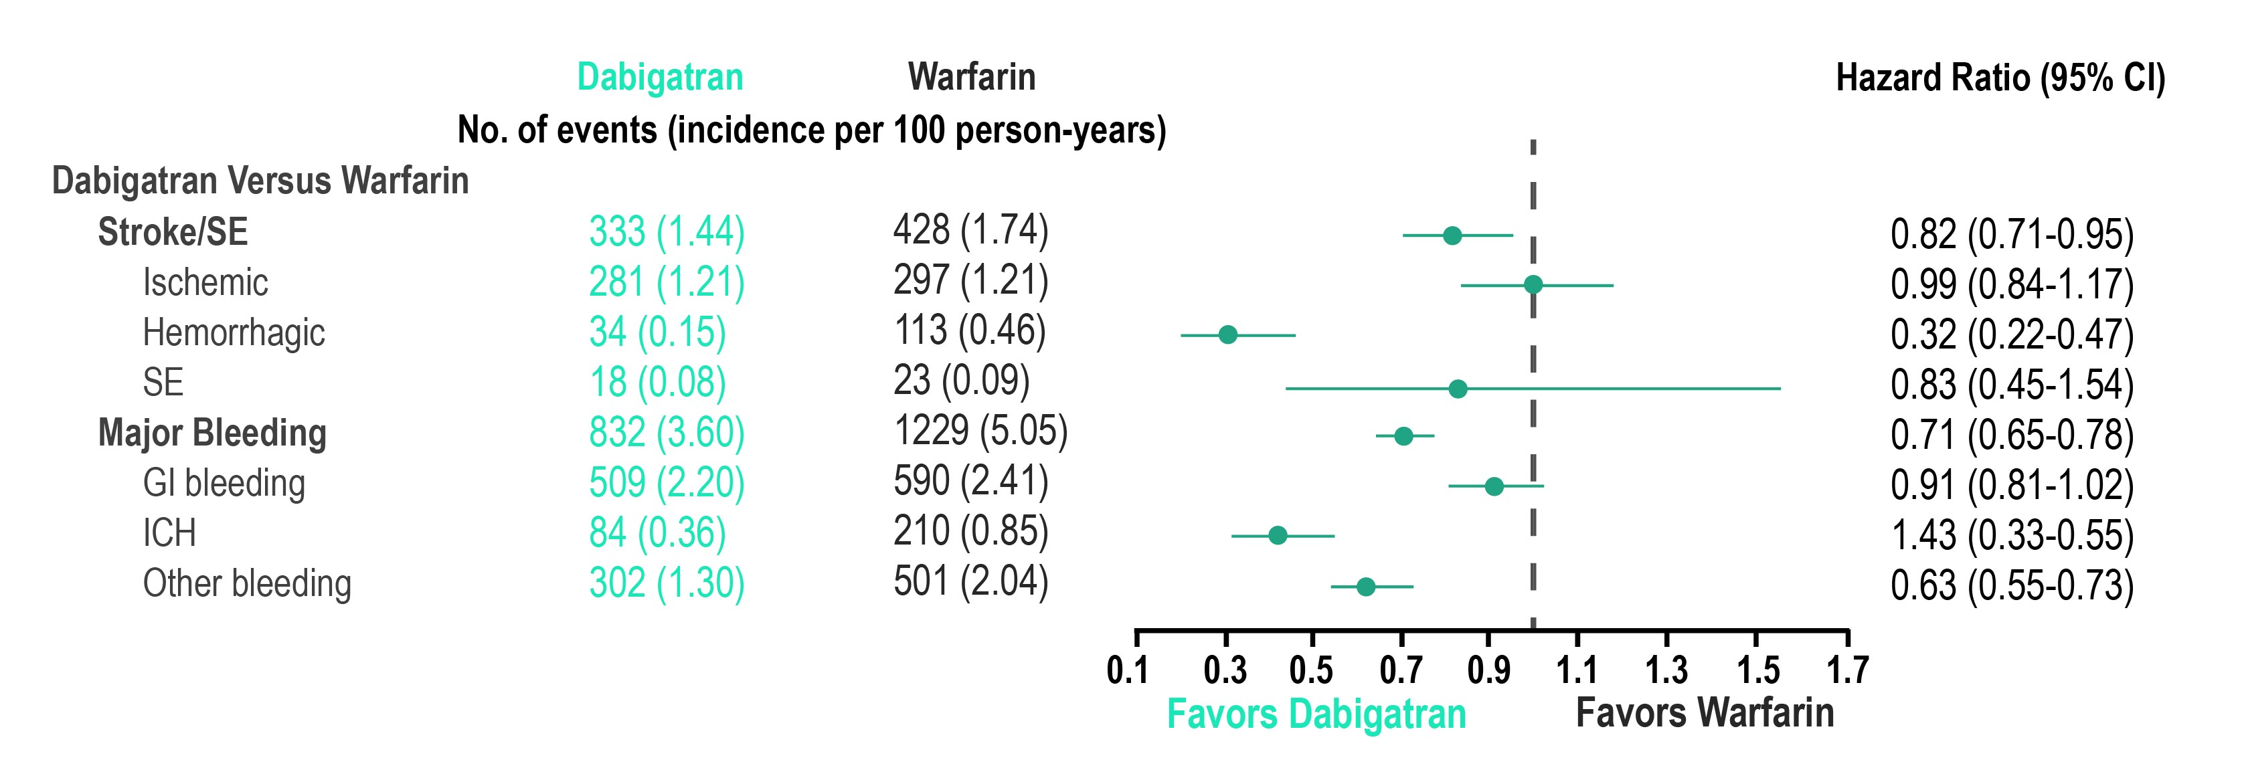
Main Analysis: Incidence Rates and Hazard Ratios of Stroke/SE and Major Bleeding in Dabigatran–Warfarin Propensity Score-Matched Cohorts
Limitations: No adequate, well-controlled head-to-head clinical trials have been conducted comparing the efficacy and safety of NOACs. Each cohort was matched separately. Therefore, it is not appropriate to compare across the cohorts.
CI, confidence interval; GI, gastrointestinal; ICH, intracranial hemorrhage; NOAC, non-vitamin K antagonist oral anticoagulant; NVAF, nonvalvular atrial fibrillation; SE, systemic embolism.
Lip et al. Stroke. 2018;49:2933-2944; updated January 10, 2020.
Notes:
Speaker Notes:
Authors’ Summary: Compared with warfarin, dabigatran was associated with lower rates of stroke/SE, hemorrhagic stroke, major bleeding, ICH, and other bleeding.

Slide 30
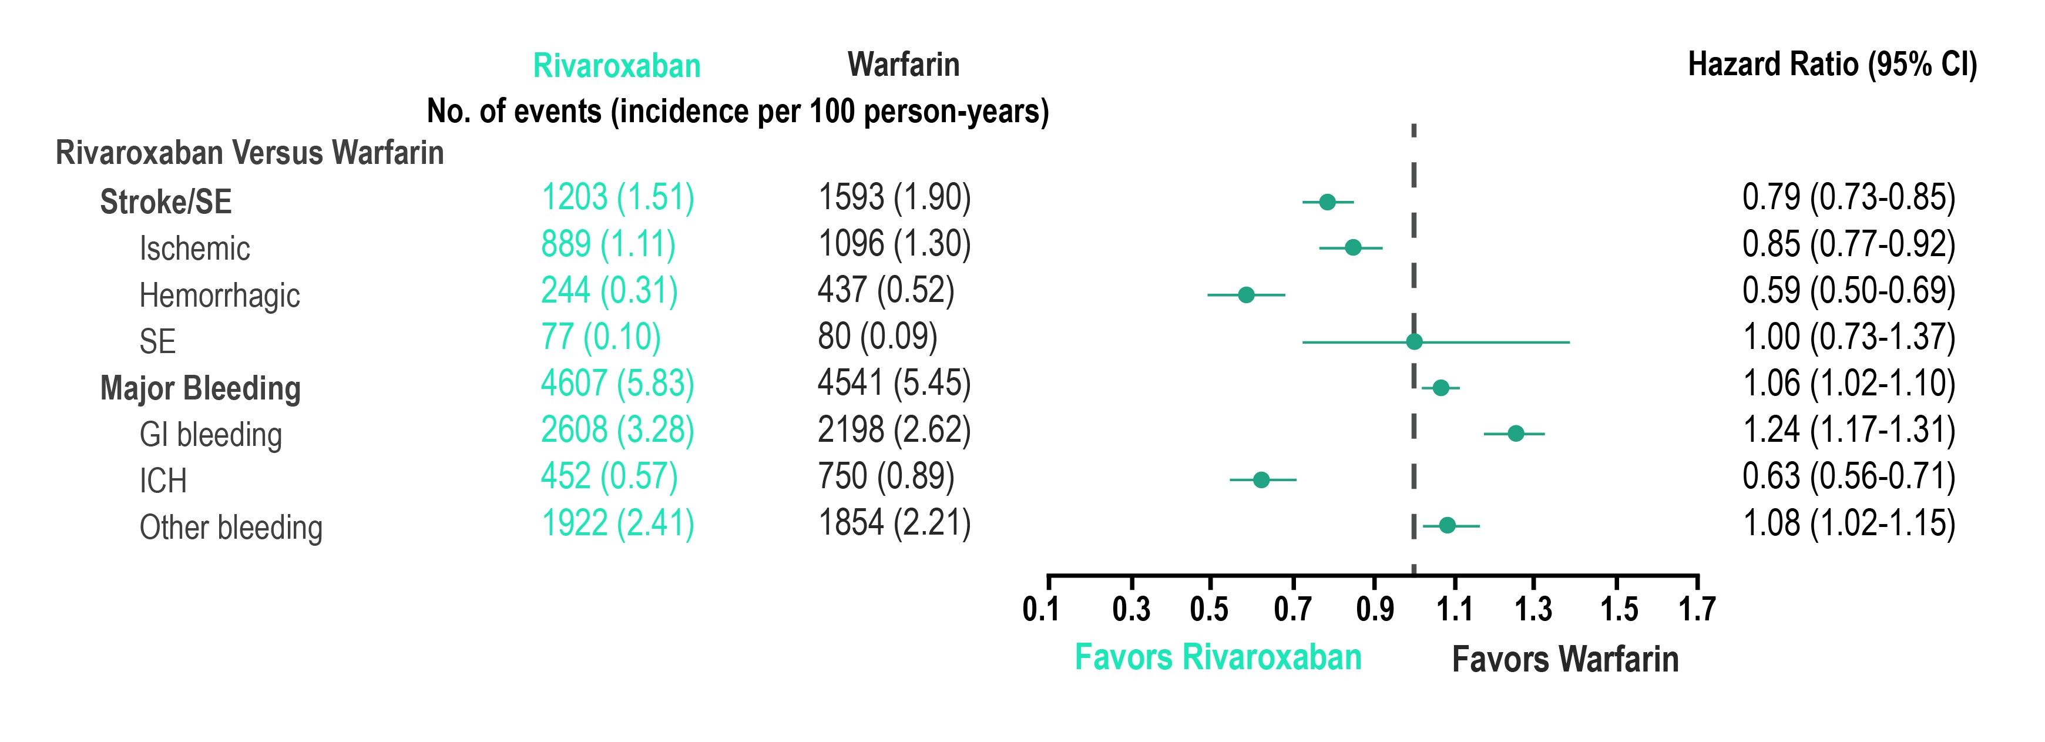
Main Analysis: Incidence Rates and Hazard Ratios of Stroke/SE and Major Bleeding in Rivaroxaban–Warfarin Propensity Score-Matched Cohorts
Limitations: No adequate, well-controlled head-to-head clinical trials have been conducted comparing the efficacy and safety of NOACs. Each cohort was matched separately. Therefore, it is not appropriate to compare across the cohorts.
CI, confidence interval; GI, gastrointestinal; ICH, intracranial hemorrhage; NOAC, non-vitamin K antagonist oral anticoagulant; NVAF, nonvalvular atrial fibrillation; SE, systemic embolism.
Lip et al. Stroke. 2018;49:2933-2944; updated January 10, 2020.
Notes:
Speaker Notes:
Authors’ Summary: Compared with warfarin, rivaroxaban was associated with lower rates of stroke/SE, ischemic stroke, hemorrhagic stroke, and ICH, but higher rates of major bleeding, GI bleeding, and other bleeding.

Slide 31
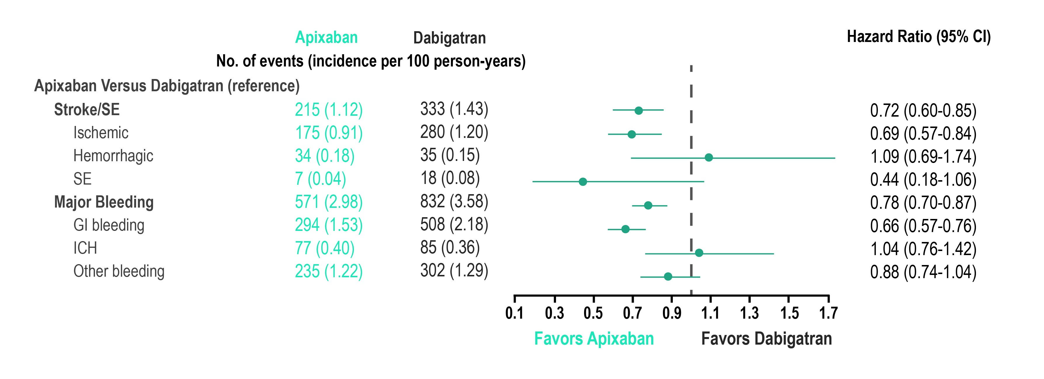
Main Analysis: Incidence Rates and Hazard Ratios of Stroke/SE and Major Bleeding in Apixaban–Dabigatran Propensity Score-Matched Cohorts
Limitations: No adequate, well-controlled head-to-head clinical trials have been conducted comparing the efficacy and safety of NOACs. Each cohort was matched separately. Therefore, it is not appropriate to compare across the cohorts.
CI, confidence interval; GI, gastrointestinal; ICH, intracranial hemorrhage; NOAC, non-vitamin K antagonist oral anticoagulant; NVAF, nonvalvular atrial fibrillation; SE, systemic embolism.
Lip et al. Stroke. 2018;49:2933-2944; updated January 10, 2020.
Notes:
Speaker Notes:
Authors’ Summary: Compared with dabigatran, apixaban was associated with lower rates of stroke/SE and major bleeding.

Slide 32
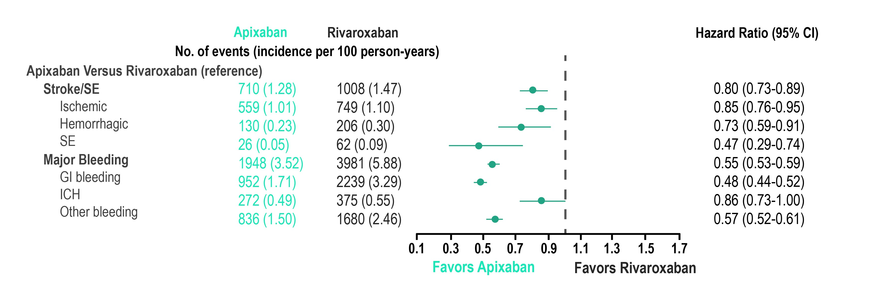
Main Analysis: Incidence Rates and Hazard Ratios of Stroke/SE and Major Bleeding in Apixaban–Rivaroxaban Propensity Score-Matched Cohorts
Limitations: No adequate, well-controlled head-to-head clinical trials have been conducted comparing the efficacy and safety of NOACs. Each cohort was matched separately. Therefore, it is not appropriate to compare across the cohorts.
CI, confidence interval; GI, gastrointestinal; ICH, intracranial hemorrhage; NOAC, non-vitamin K antagonist oral anticoagulant; NVAF, nonvalvular atrial fibrillation; SE, systemic embolism.
Lip et al. Stroke. 2018;49:2933-2944; updated January 10, 2020.
Notes:
Speaker Notes:
Authors’ Summary: Compared with rivaroxaban, apixaban was associated with lower rates of stroke/SE and major bleeding

Slide 33
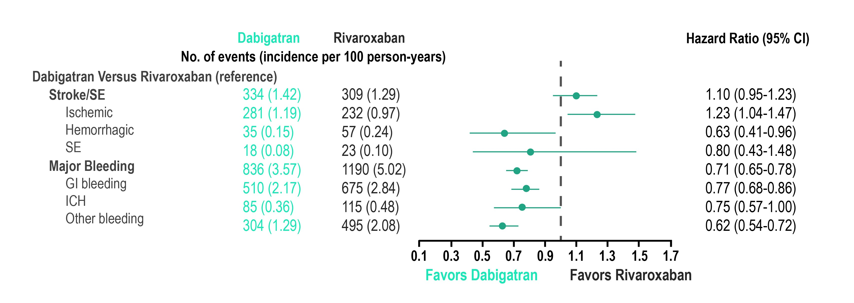
Main Analysis: Incidence Rates and Hazard Ratios of Stroke/SE and Major Bleeding in Dabigatran–Rivaroxaban Propensity Score-Matched Cohorts
Limitations: No adequate, well-controlled head-to-head clinical trials have been conducted comparing the efficacy and safety of NOACs. Each cohort was matched separately. Therefore, it is not appropriate to compare across the cohorts.
CI, confidence interval; GI, gastrointestinal; ICH, intracranial hemorrhage; NOAC, non-vitamin K antagonist oral anticoagulant; NVAF, nonvalvular atrial fibrillation; SE, systemic embolism.
Lip et al. Stroke. 2018;49:2933-2944; updated January 10, 2020.
Notes:
Speaker Notes:
Authors’ Summary: Compared with rivaroxaban, dabigatran was associated with a similar rate of stroke/SE and a lower rate of major bleeding.

Slide 34
Effectiveness and Safety of Dabigatran, Rivaroxaban, and Apixaban Versus Warfarin in Nonvalvular Atrial Fibrillation
Yao X, Abraham NS, Sangaralingham LR, Bellolio MF, McBane RD, Shah ND, Noseworthy PA
Yao et al. J Am Heart Assoc. 2016;5:e003725
Notes:
Speaker Notes:
Cohort Creation
Apixaban, dabigatran, rivaroxaban or warfarin users (10/1/2010-6/30/2015) N=1,873,941
12-month continuous enrollment N= 289,246 warfarin and N=83,084 DOAC
Patients with AF at baseline N=176,723
Exclude: valvular heart disease, ESRD/dialysis N=126,178
Final sample:
Dabigatran vs Warfarin (N=28,614)
Rivaroxaban vs Warfarin (N=32,350)
Apixaban vs Warfarin (N=15,390)
Propensity matching on 38 clinical variables

Slide 35
Apixaban vs. Warfarin
 |  | ARISTOLE Apixaban vs. Warfarin
 |  | HR (95% CI)
Stroke or systemic embolism |  | 0.79* (0.66, 0.95)
Major Bleeding |  | 0.69*** (0.60, 0.80)
Intracranial |  | 0.42*** (0.30, 0.58)
OLDW
Apixaban vs. Warfarin
HR (95% CI)
0.67* (0.46, 0.98)
0.45*** (0.34, 0.59)
0.24*** (0.12, 0.50)
*p<0.05, **p<0.01, ***p<0.001
Yao, Noseworthy JAHA 2016
Notes:
Speaker Notes:

Slide 36
Dabigatran vs. Warfarin
 |  | RE-LY Dabigatran vs. Warfarin
 |  | HR (95% CI)
Stroke or systemic embolism |  | 0.66*** (0.53, 0.82)
Major bleeding |  | 0.93 (0.81, 1.07)
Intracranial |  | 0.40*** (0.27, 0.60)
OLDW
Dabigatran vs. Warfarin
HR (95% CI)
0.98 (0.76, 1.26)
0.79** (0.64, 0.94)
0.36*** (0.23, 0.56)
*p<0.05, **p<0.01, ***p<0.001
†RE-LY results are from 150 mg; RE-LY used intent-to-treat analysis for safety outcomes
Yao, Noseworthy JAHA 2016
Notes:
Speaker Notes:

Slide 37
Rivaroxaban vs. Warfarin
 |  | ROCKET-AF Rivaroxaban vs. Warfarin
 |  | HR (95% CI)
Stroke or systemic embolism |  | 0.88 (0.75, 1.03)
Major Bleeding |  | 1.04 (0.90, 1.20)
Intracranial |  | 0.67* (0.47, 0.93)
OLDW
Rivaroxaban vs. Warfarin
HR (95% CI)
0.93 (0.72, 1.19)
1.04 (0.90, 1.20)
0.51*** (0.35, 0.75)
*p<0.05, **p<0.01, ***p<0.001
Yao, Noseworthy JAHA 2016
Notes:
Speaker Notes:

Slide 38
What are the other implications of a Once-Daily versus Twice-Daily DOAC?

Slide 39

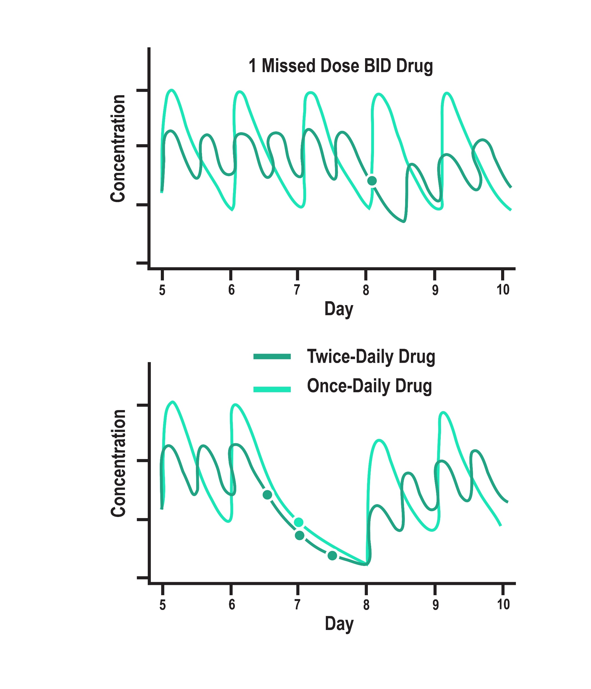
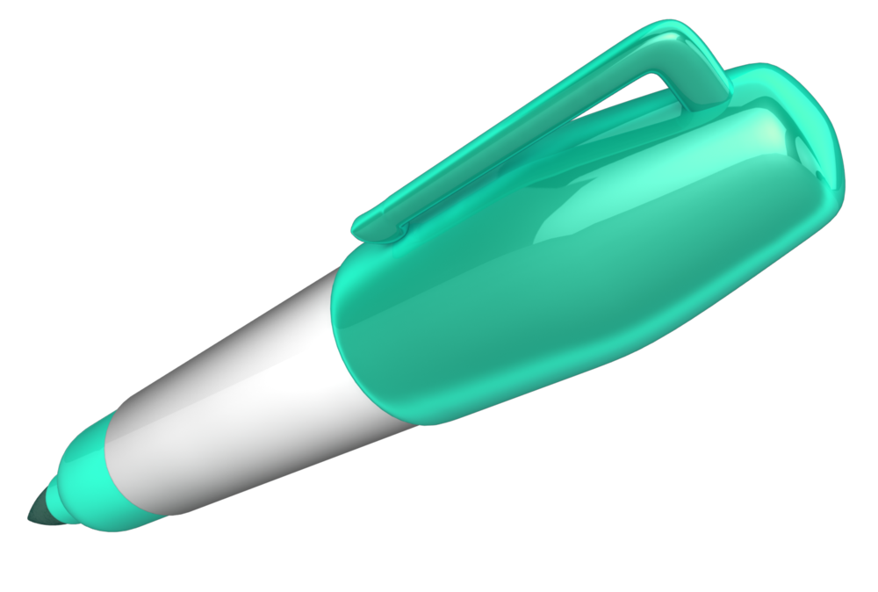
Dosing Considerations and Implications of a Single Missed Dose
1 missed QD dose equals 3 missed BID doses
Dosing also has implications on the impact of a single missed dose.
One missed dose of QD drug ≠ One missed dose of BID drug
Comparative effects of prescribing the same total daily dose, given either once-daily (QD) or as half-strength twice-daily (BID) doses, for the same drug, or 2 drugs with identical pharmacokinetic parameters:
Twice-daily dosing regimen is less prone to high peaks or low troughs in anticoagulant concentrations and associated actions.
Disproportionately greater impact on drug action of skipping a once-daily than a twice-daily dose
Vrijens B, Heidbuchel H. Europace. 2015 Apr;17(4):514-23.
Notes:
Speaker Notes:
From a pharmacodynamics standpoint for DOACs with a short 12 hour half-life, missing a dose of a once-daily drug exposes to patient to a period of relative under-anticoagulation and risk of stroke/SE. By the time the next dose is taken, 48 hours (or four half-lives) have potentially elapsed and only 12.5% of the DOAC remains in the system.
A patient would have to miss three consecutive doses of a DOAC taken twice-daily for an equivalent risk exposure. Being on a once-daily DOAC may therefore not be an advantage for a forgetful patient who frequently misses doses as he/she is less likely to miss three consecutive doses of medication.

Slide 40
What does persistence and adherence with DOACs look like?

Slide 41
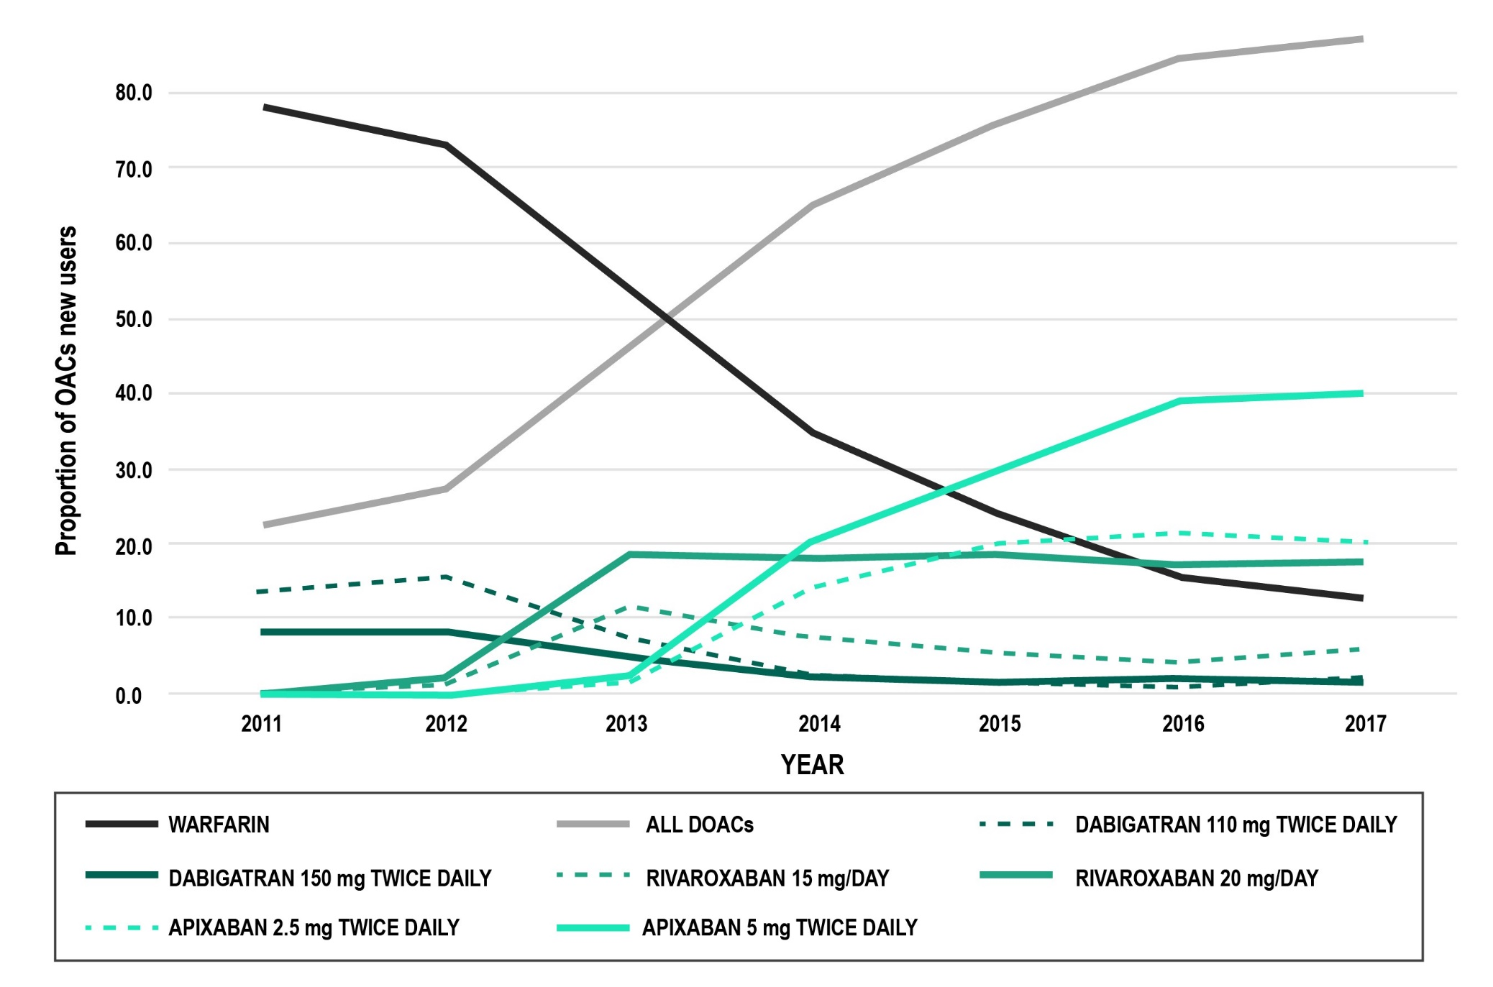
Oral Anticoagulation Prescription Trends, Profile Use and Determinants of Adherence in Patients with AF
N=33311 new OAC users
Warfarin use ↓ 77.9% -> 12.7%
DOAC use ↑ 22.1 -> 87.3%
60,1% Api, 23.4% Riva
Persistence at 1 year :
Range 53% W - 77% hi dose Api
Adherence (≥ 80% PDC) : 75%
Best in older hi risk females and
With a Hx of CVD
Adherence to OACs remains a significant challenge in patients with AF
RAMQ database from 2011-2017
Perreault S et al. Pharmacotherapy 2020;40(1):40–54
Notes:
Speaker Notes:
Abstract
Background and Purpose
Data on oral anticoagulant (OAC) uptake and pattern of use are limited. Real‐life data in patients with atrial fibrillation (AF) are important for understanding patient exposure. A cohort study of new OAC users was built to assess trends of drug use from 2011 to 2017, persistence rate, switching rate, adherence level, and predictors of adherence.
Methods
We built a cohort using the Régie d’Assurance Maladie du Québec (RAMQ) and Med‐Echo administrative databases of new adult OAC users within 1 year following hospitalization with a diagnosis of AF. New users of OAC were defined as having no OAC claims in the year before cohort entry. We assessed trends of OAC use; persistence rate, defined as a gap between refills of no longer than two times the duration of the previous prescriptions; and adherence level, defined as the proportion of days covered (PDC) over a 1‐year period following initiation. Predictors of nonadherence (PDC less than 80%) were analyzed using logistic regression models.
Results
The cohort consisted of 33,311 incident OAC users. Of total OAC claims, the proportions of warfarin claims decreased from 77.9% in 2011 to 12.7% in 2017, with direct oral anticoagulants (DOACs) accounting for 87.3% of claims, of which apixaban and rivaroxaban accounted for 60.1% and 23.4%, respectively, by the end of 2017. One year after OAC initiation, persistence rates ranged from 53% with warfarin to 77% with a high dose of apixaban. Approximately 75% of incident OAC users were considered “adherent” (PDC 80% or more), with a mean PDC of 95.6–98.1%, compared with “nonadherent,” with a mean PDC varying between 43.1% and 50.7%. Older age, female sex, higher CHA₂DS₂‐VASc score (to predict thromboembolic risk in AF), prior stroke, and treatment with chronic cardiovascular disease drugs were associated with high adherence levels.
Conclusion
The clinical uptake of DOACs increased over time, accounting for 87.3% of prescriptions in 2017. In our study, 25% of new OAC users presented a low adherence level. Adherence to OACs remains a significant challenge in patients with AF.

Slide 42
Mayo Clinic Real World Data Analysis of Non-Adherence
Mean age 73 yrs (IQR 64-80 yrs); 56% male
89.6% had CHA₂DS₂-VASc ≥2, 47.8% had HAS-BLED ≥3
Compliance defined as ≥80% of days covered by OAC
Adjusted for potential confounders
52.1
47.6
45.9
Compliance (%)
38.7
Apixaban
Rivaroxaban
Dabigatran
Warfarin
Perreault S et al. Pharmacotherapy 2020;40(1):40–54
Notes:
Speaker Notes:
Abstract
Background and Purpose
Data on oral anticoagulant (OAC) uptake and pattern of use are limited. Real‐life data in patients with atrial fibrillation (AF) are important for understanding patient exposure. A cohort study of new OAC users was built to assess trends of drug use from 2011 to 2017, persistence rate, switching rate, adherence level, and predictors of adherence.
Methods
We built a cohort using the Régie d’Assurance Maladie du Québec (RAMQ) and Med‐Echo administrative databases of new adult OAC users within 1 year following hospitalization with a diagnosis of AF. New users of OAC were defined as having no OAC claims in the year before cohort entry. We assessed trends of OAC use; persistence rate, defined as a gap between refills of no longer than two times the duration of the previous prescriptions; and adherence level, defined as the proportion of days covered (PDC) over a 1‐year period following initiation. Predictors of nonadherence (PDC less than 80%) were analyzed using logistic regression models.
Results
The cohort consisted of 33,311 incident OAC users. Of total OAC claims, the proportions of warfarin claims decreased from 77.9% in 2011 to 12.7% in 2017, with direct oral anticoagulants (DOACs) accounting for 87.3% of claims, of which apixaban and rivaroxaban accounted for 60.1% and 23.4%, respectively, by the end of 2017. One year after OAC initiation, persistence rates ranged from 53% with warfarin to 77% with a high dose of apixaban. Approximately 75% of incident OAC users were considered “adherent” (PDC 80% or more), with a mean PDC of 95.6–98.1%, compared with “nonadherent,” with a mean PDC varying between 43.1% and 50.7%. Older age, female sex, higher CHA₂DS₂‐VASc score (to predict thromboembolic risk in AF), prior stroke, and treatment with chronic cardiovascular disease drugs were associated with high adherence levels.
Conclusion
The clinical uptake of DOACs increased over time, accounting for 87.3% of prescriptions in 2017. In our study, 25% of new OAC users presented a low adherence level. Adherence to OACs remains a significant challenge in patients with AF.

Slide 43

Key Messages
AF is a common and important cause of stroke and needs to be rigorously ruled out in idiopathic stroke
Appropriate anticoagulation treatment should be started when indicated in the vast majority of AF patients as per the 2018 CCS guidelines
DOACs offer several advantages over warfarin, and should generally be used in preference to warfarin for SPAF as per 2018 CCS guidelines
Risk of bleeding should be modified where possible but very rarely outweighs the risk of stroke
Patient characteristics and co-morbidities (age, renal function, etc) should be considered when selecting and dosing DOACs
Real world evidence provides reassurance of the efficacy and safety of DOACs in SPAF but highlights the challenges of correct dosing and compliance
Notes:
Speaker Notes:
Most patients with AF and CAD who are eligible for OAC according to CHADS-65 end up on a DOAC alone after 12 months of CAD “stability”, defined as no ACS or need for revascularization (PCI or CABG).

